Slide 1
A Programmers Introduction to the PlayStation 2
Course 1
PS2 Lecture Series

Slide 2
Introduction
System Architecture
  Emotion Engine (CPU)
  DMA Controller
  Vector Units (VU)
  GS
Data Flow

Slide 3
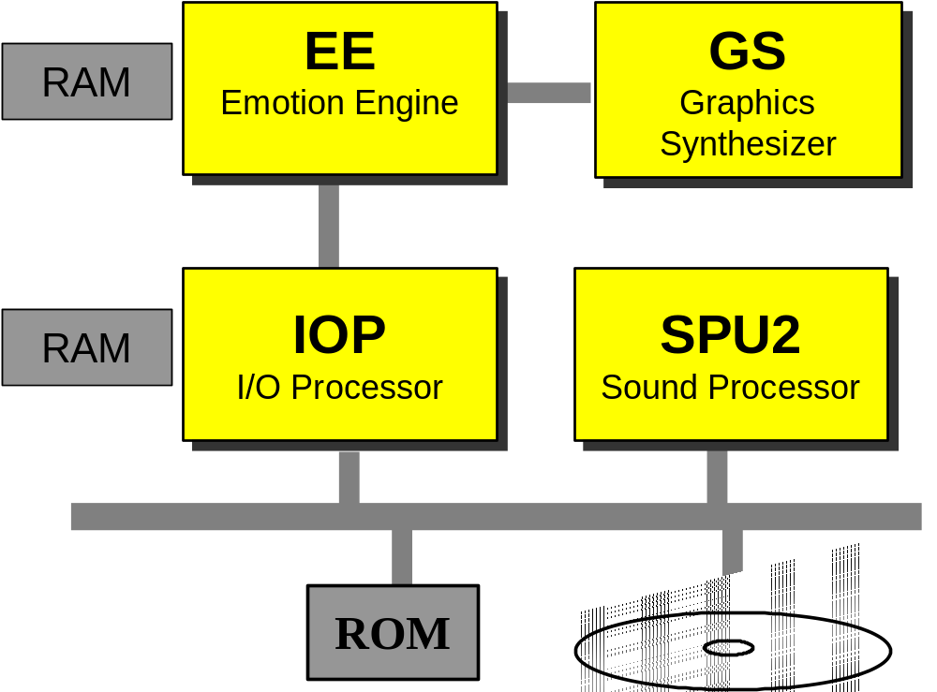
System Block Diagram

Slide 4
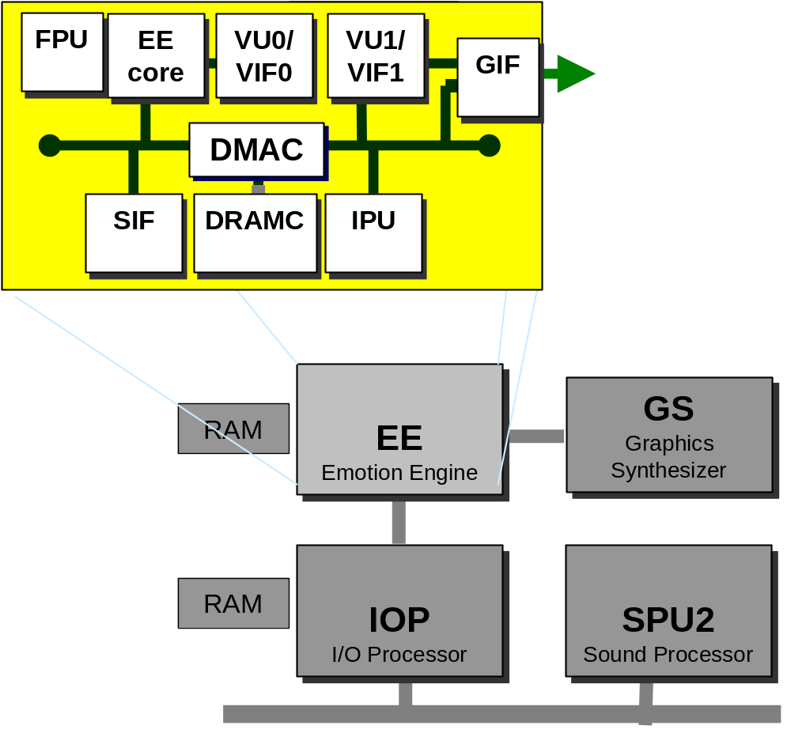
EE Block Diagram

Slide 5
The EE CPU
300 mhz
32 128-bit General Purpose Registers
Two-way Superscalar (two 32-bit instructions/cycle)
64-bit MIPS Instruction set
128 bit Multimedia Instructions (Like MMX)
Large caches
  16K Instruction Cache
  8K Data Cache
  16K ScratchPad
2 Coprocessors
  FPU and VU0

Slide 6
DMA Controller
DMAC
  Handles transfers between various components
    i.e. Main RAM -> Scratchpad
  128-bit transfer size
  Increases "parallelism"
  Critical to achieving peak performance

Slide 7
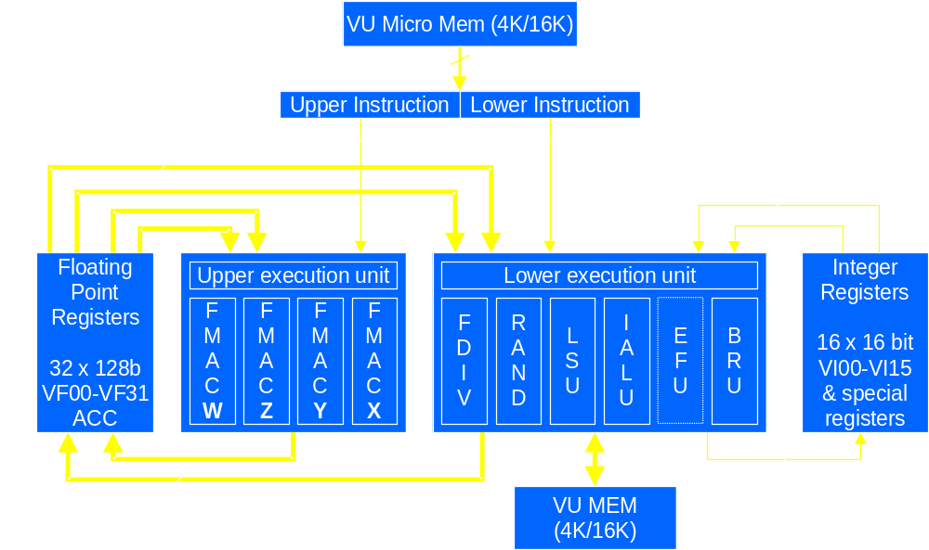
VU Architecture

Slide 8
VU Programming Example
Upper Instruction Lower Instruction
LOOP: MUL VF05, VF04, Q DIV Q, 1.0, VF03w
MUL ACC, VF10, VF01x MOVE VF04, VF03
MADD ACC, VF11, VF01y MOVE VF03, VF02
MADD ACC, VF12, VF01z ADD VI03, VI03, -1
MADD VF02, VF13, VF01w LQ VF01, VI01++
NOP IBGTZ VI03, LOOP
NOP SQ VF05, VI02++

Slide 9
Graphics Synthesizer
Primitive drawing engine
16 pixels/cycle maximum (@147.5MHz)
Local Video memory: 4 MBytes

Slide 10
GS Primitives
Triangle
TriangleStrip
TriangleFan
Line
LineStrip
Point
Sprite

Slide 11
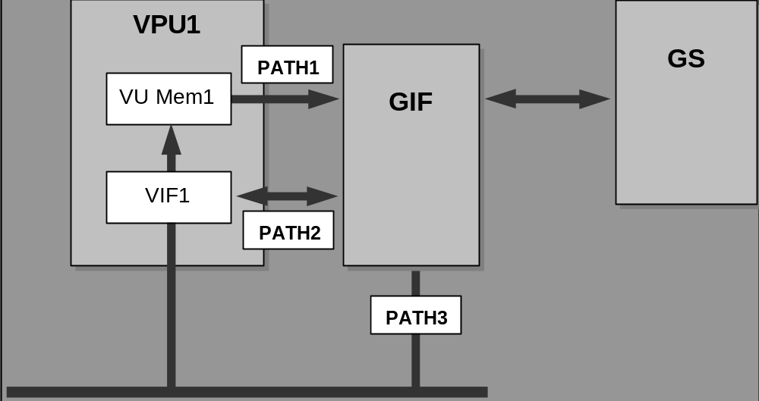
Data Flow

Slide 12
Summary
PS2 is a loosely coupled multi-processor machine
Data flow is very important for performance
Notes:
Summary

